Slide 1
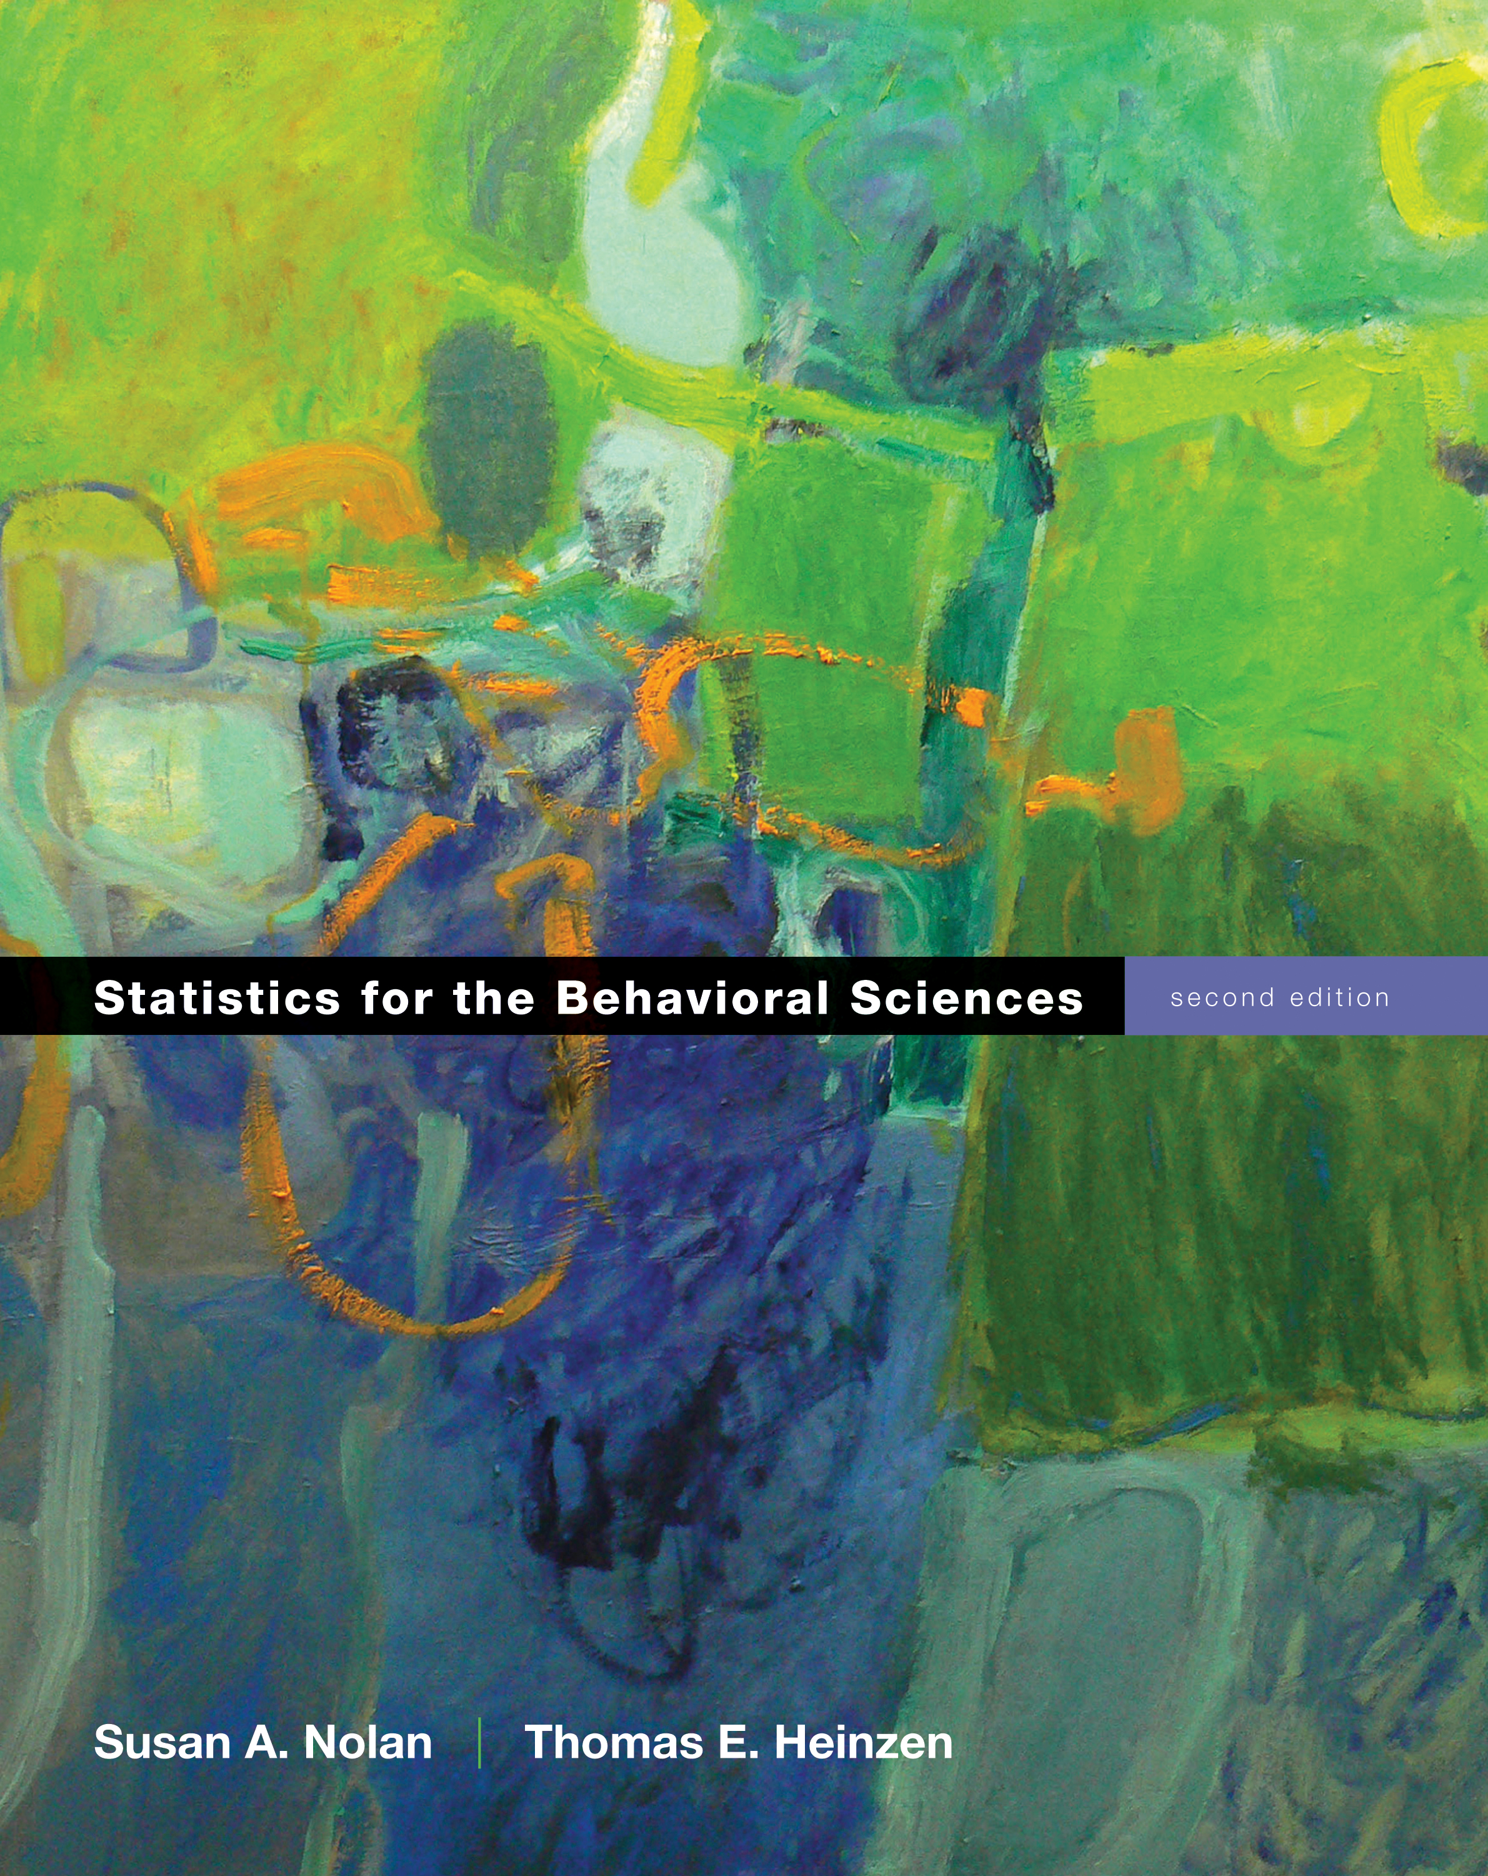
The Normal Curve, Standardization and z Scores
Chapter 6

Slide 2
Freakanomics!
Go go go!

Slide 3
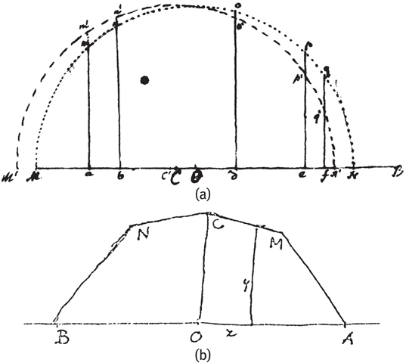
The Bell Curve is Born (1769)
De Moivre – Bernoulli – De Morgan

Slide 4
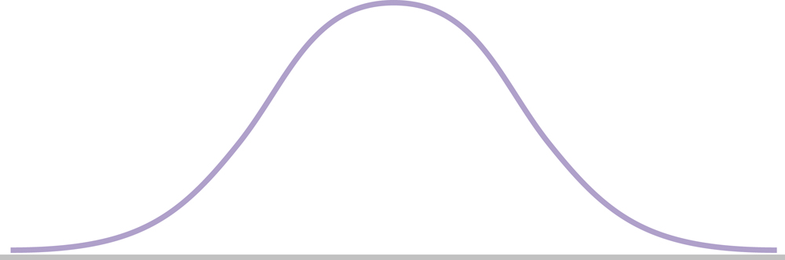
A Modern Normal Curve
Remember: unimodal, symmetric

Slide 5
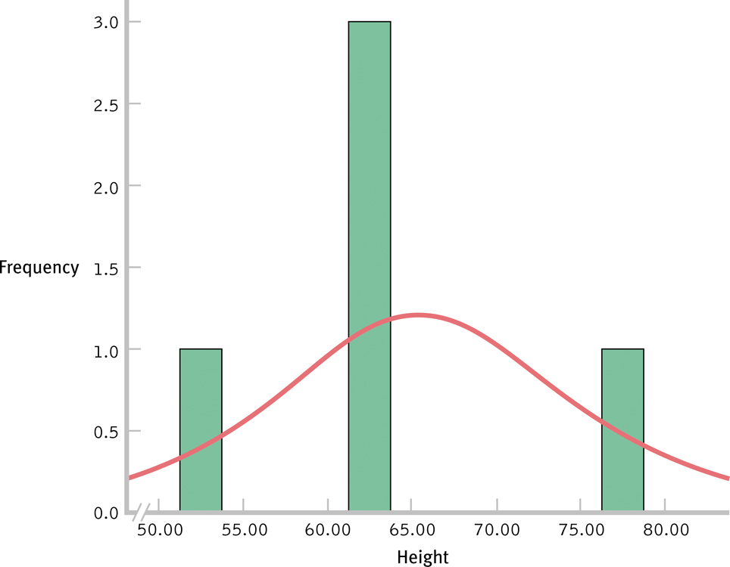
Development of a Normal Curve: Sample of 5

Slide 6
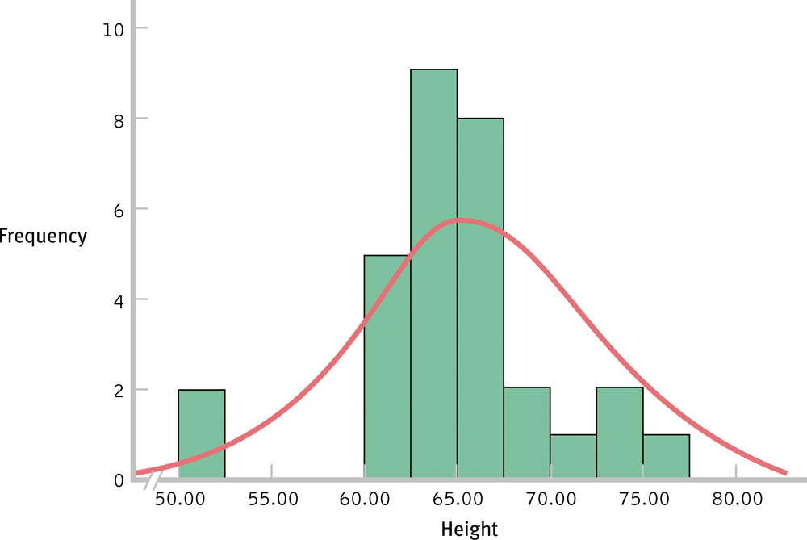
Development of a Normal Curve: Sample of 30

Slide 7
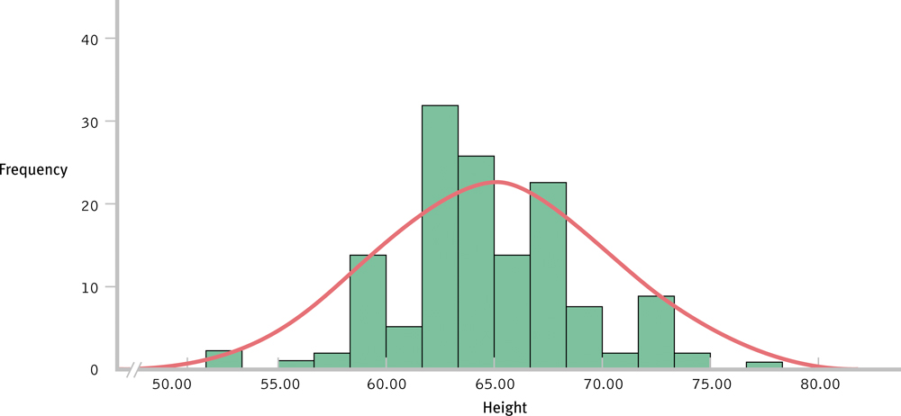
Development of a Normal Curve: Sample of 140

Slide 8
As the sample size increases, the shape of the distribution becomes more like the normal curve.
Can you think of variables that might be normally distributed?
Think about it: Can nominal (categorical) variables be normally distributed?

Slide 9
Standardization, z Scores, and the Normal Curve
Let’s say we wanted to compare our student scores on the old GRE (800 point scale) to the new GRE (170 point scale)
Standardization: allows comparisons by creating a common shared distribution
Also allows us to create percentiles (p-values!)

Slide 10
Standardization, z Scores, and the Normal Curve
Normal curve = standardized
z distribution (draw it)
z scores
Comparing z scores
percentiles

Slide 11
Standardization, z Scores, and the Normal Curve
Z-distribution – normal distribution of standardized scores
Also called standard normal distribution

Slide 12
Standardization, z Scores, and the Normal Curve
So what are z-scores?
Number of standard deviations away from the mean of a particular score
Can be positive or negative
Positive = above mean
Negative = below mean
Tip! Make yourself a symbols chart!

Slide 13
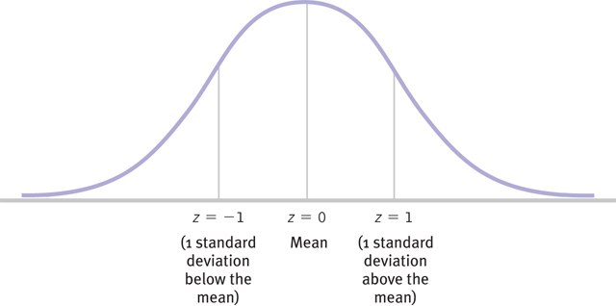
The z Distribution

Slide 14
Standardization, z Scores, and the Normal Curve
Z-distribution
Mean = 0
Standard deviation = 1

Slide 15
Remember you can get the statistical tables by going to appendix B.1 for the z-distribution table.
Linked on blackboard as a DOC as well.
Examples
Find a z score
Find a raw score (x)
Find a percent above
Find a percent below
Find a percent between
Given percent find a z
Given percent find a raw score

Slide 16
Transforming Raw Scores to z Scores
Step 1: Subtract the mean of the population from the raw score
Step 2: Divide by the standard deviation of the population

Slide 17
Transforming z Scores into Raw Scores
Step 1: Multiply the z score by the standard deviation of the population
Step 2: Add the mean of the population to this product

Slide 18
Using z Scores to Make Comparisons
If you know your score on an exam, and a friend’s score on an exam, you can convert to z scores to determine who did better and by how much.
z scores are standardized, so they can be compared!

Slide 19
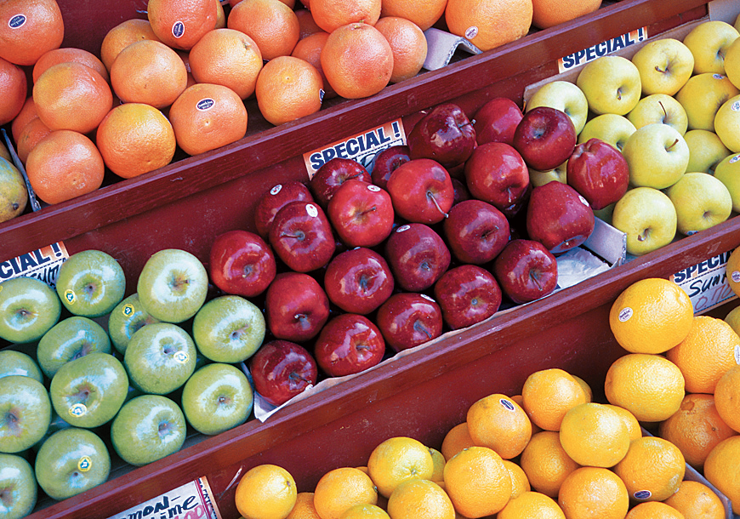
Comparing Apples and Oranges
If we can standardize the raw scores on two different scales, converting both scores to z scores, we can then compare the scores directly.

Slide 20
Transforming z Scores into Percentiles
z scores tell you where a value fits into a normal distribution.
Based on the normal distribution, there are rules about where scores with a z value will fall, and how it will relate to a percentile rank.
You can use the area under the normal curve to calculate percentiles for any score.

Slide 21
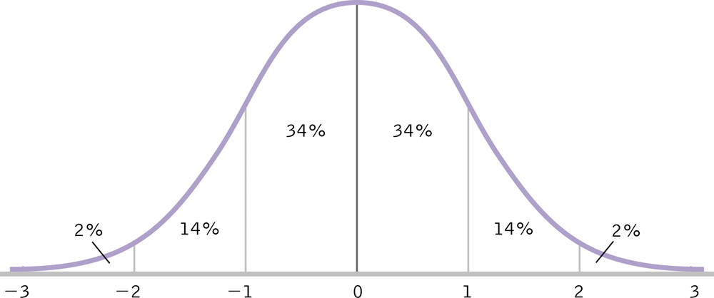
The Normal Curve and Percentages
Called the 34-14 rule

Slide 22
Remember you can get the statistical tables by going to appendix B.1 for the z-distribution table.
Linked on blackboard as a DOC as well.
Examples
Find a z score
Find a raw score (x)
Find a percent above
Find a percent below
Find a percent between
Given percent find a z
Given percent find a raw score

Slide 23
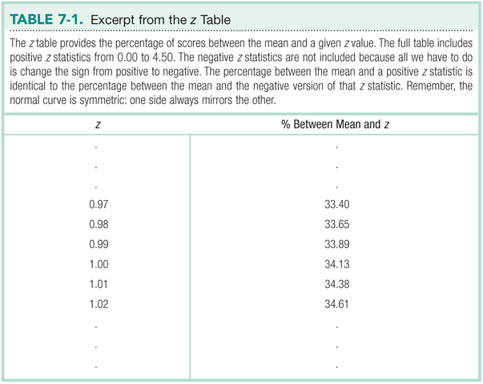

Slide 24
Remember
Only the positive numbers are on the table
The z distribution is normal, so we don’t need the negatives (it’s symmetric).

Slide 25
Sketching the Normal Curve
The benefits of sketching the normal curve:
Stays clear in memory; minimizes errors
Practical reference
Condenses the information

Slide 26
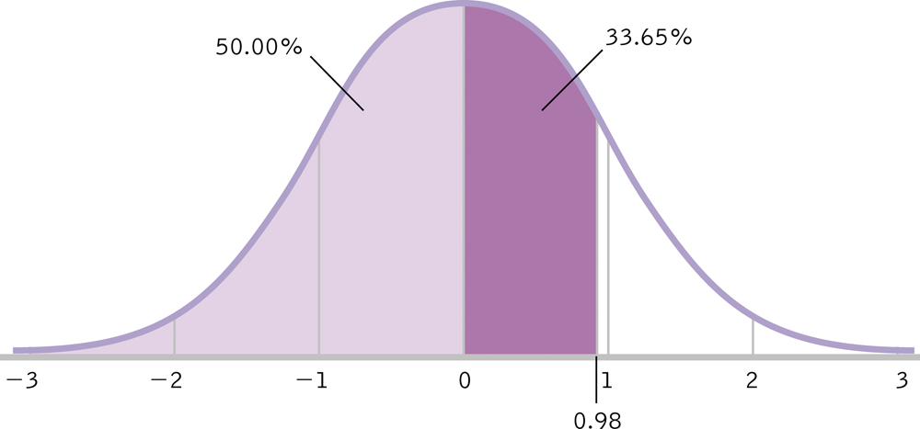
Calculating the Percentile for a Positive z Score

Slide 27
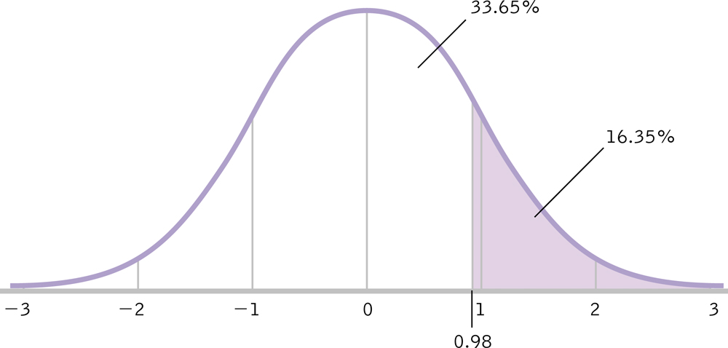
Calculating the Percentage Above a Positive z Score

Slide 28
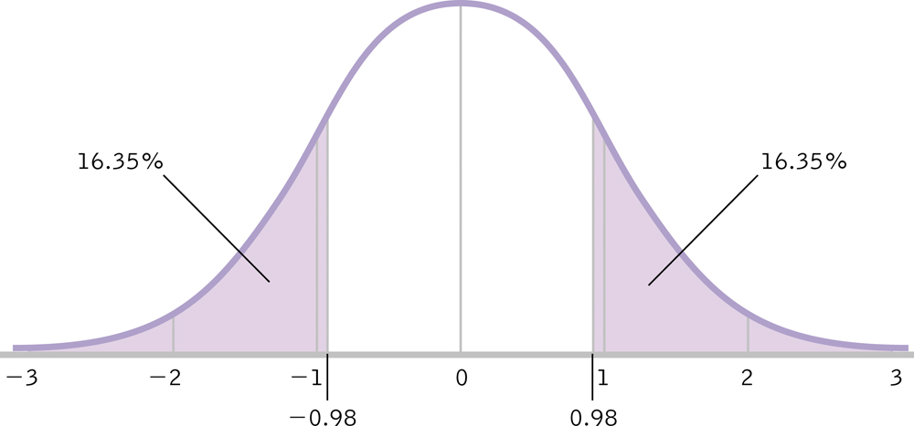
Calculating the Percentage at Least as Extreme as Our z Score

Slide 29
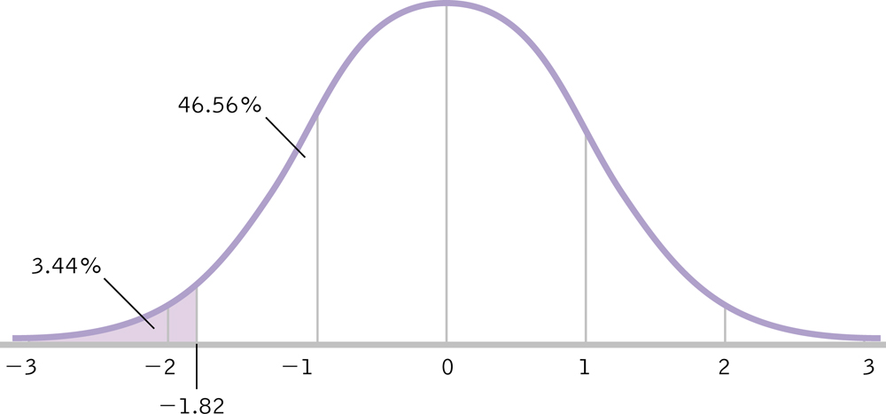
Calculating the Percentile for a Negative z Score

Slide 30
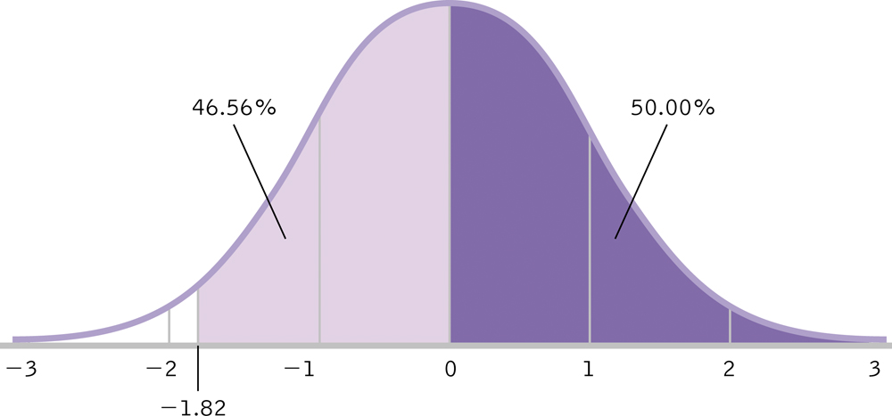
Calculating the Percentage Above a Negative z Score

Slide 31
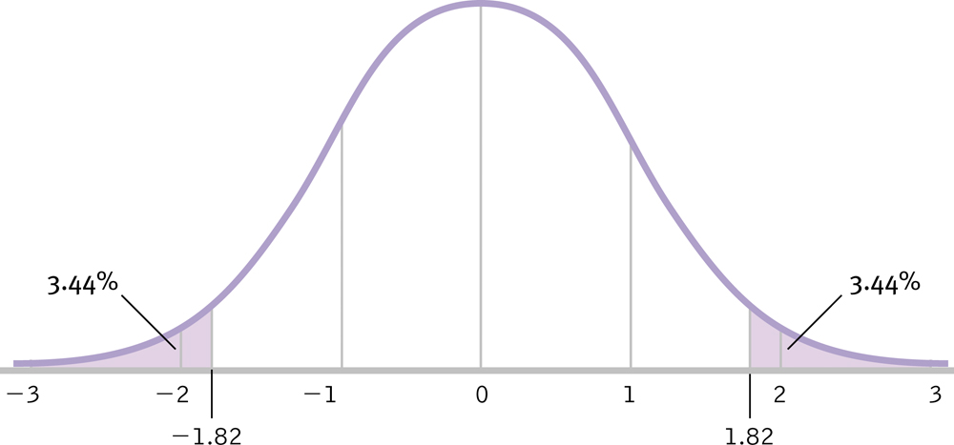
Calculating the Percentage at Least as Extreme as Our z Score

Slide 32
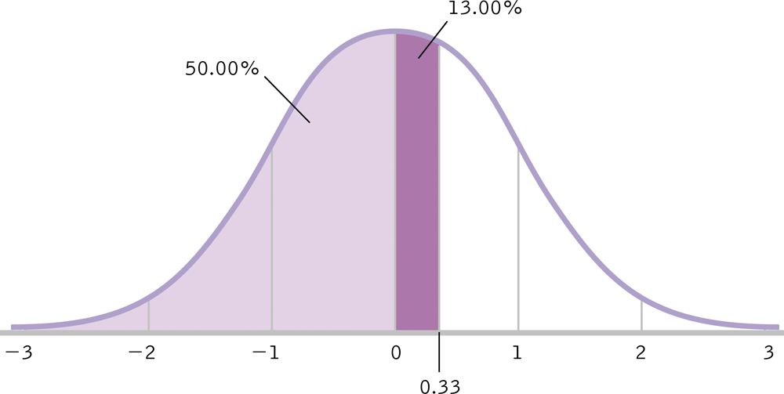
Calculating a Score from a Percentile

Slide 33
The Central Limit Theorem
Distribution of sample means is normally distributed even when the population from which it was drawn is not normal!
A distribution of means is less variable than a distribution of individual scores.
(meaning SD is smaller, but we don’t call it SD)
Most of statistics is based on making beer better.
Which is why it’s awesome!

Slide 34
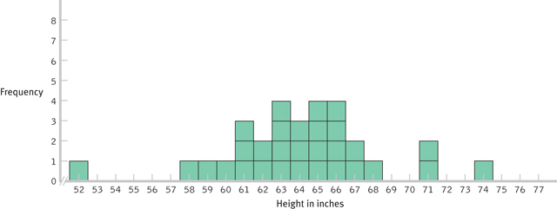
Creating a Distribution of Scores
These distributions were obtained by drawing from the same population.

Slide 35
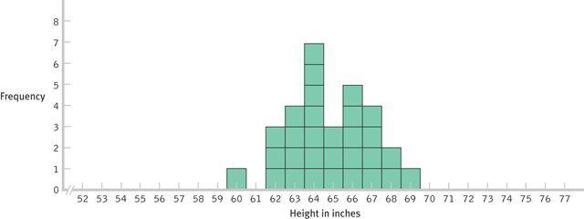
Creating a Distribution of Means

Slide 36
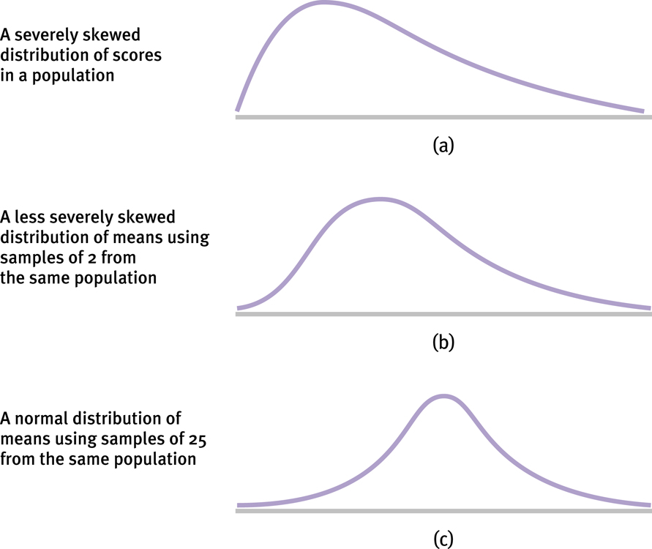
The Mathematical Magic of Large Samples

Slide 37
Distribution of Means
Mean of the distribution tends to be the mean of the population.
Standard deviation of the distribution tends to be less than the standard deviation of the population.
The standard error: standard deviation of the distribution of means

Slide 38
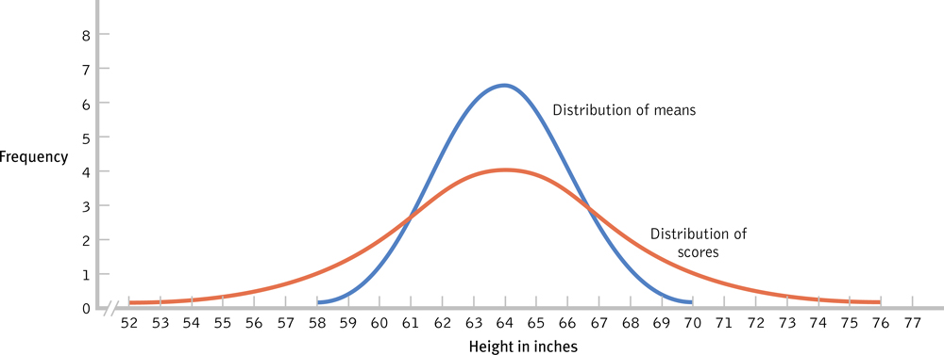
Using the Appropriate Measure of Spread

Slide 39
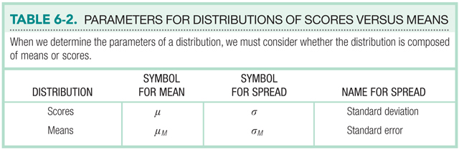

Slide 40
Z statistic for Distribution of Means
When you use a distribution of means, you tweak how you calculate z!
Calculation of percentages stays the same.
z = M – μ_{M}
σ_{M}

Slide 41
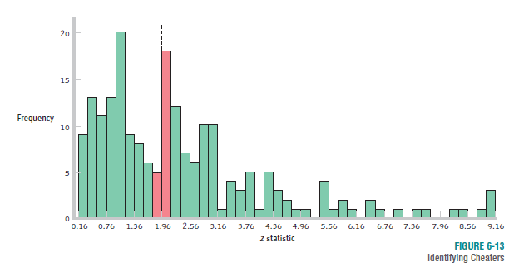
The Normal Curve and Catching Cheaters
This pattern is an indication that researchers might be manipulating their analyses to push their z statistics beyond the cutoffs.

Slide 42
PS That example was the same idea we talked about publication bias … only significant things get published.
PPS the book example is from Freakanomics!
GO HERE! (more information)

